Slide 1
Employee Data Analysis using Excel
STUDENT NAME: JAYASHREE NS
REGISTER NO:312216949
DEPARTMENT:III BCOM(G)
COLLEGE : SHRI KRISHNA SWAMY COLLEGE FOR WOMEN

Slide 2
PROJECT TITLE
"Salary & compensation Analysis through
Excel Data Modelling "

Slide 3


AGENDA
Problem Statement
Project Overview
End Users
Our Solution and Proposition
Dataset Description
Modelling Approach
Results and Discussion
Conclusion
3/21/2024 Annual Review

Slide 4

PROBLEM STATEMENT
"Conduct a comprehensive salary and compensation analysis using Excel data modeling to identify disparities, trends, and opportunities for optimization.
This analysis aims to evaluate current compensation structures, benchmark against industry standards, and propose actionable recommendations for equitable and competitive pay practices.
The ultimate goal is to support strategic decision-making in HR and ensure alignment with organizational goals."

Slide 5

PROJECT OVERVIEW
The Salary and Compensation Analysis project aims to provide a comprehensive overview of employee remuneration across various roles within an organization
•Utilizing Excel for data modeling, this project analyzes salary structures, benefits, and compensation packages to identify trends, disparities, and opportunities for optimization.
•The data-driven approach allows for the creation of interactive dashboards and visualizations, enabling stakeholders to easily interpret key findings such as average salaries by department, pay gaps, and the correlation between compensation and performance.
.

Slide 6

WHO ARE THE END USERS?
The end users of a salary and compensation analysis through Excel data modeling may include: 1. HR Professionals: Responsible for designing and implementing compensation strategies, they will use the analysis to inform decisions and ensure fair pay practices. 2. Compensation Analysts: They will utilize the data model to analyze and interpret compensation data, identifying trends and areas for improvement. 3. Business Leaders: CEOs, CFOs, and department heads will use the insights to make strategic decisions about talent management, budgeting, and resource allocation.

Slide 7

OUR SOLUTION AND ITS VALUE PROPOSITION
Our solution offers a robust Excel-based data modeling tool for Salary and Compensation Analysis, providing detailed insights into pay structures and employee compensation.
The value proposition lies in its ability to deliver accurate, data-driven decisions, ensuring fair and competitive pay across the organization.
By integrating interactive dashboards and customizable reports, the solution enhances transparency, supports strategic planning, and helps optimize compensation packagesattract and retain top talent.
Here are the potential results of Salary and Compensation Analysis through Excel data modeling:
_Insights:_
1. *Pay Equity Gaps*: Identification of gender, racial, or other demographic-based pay disparities.
2. *Market Positioning*: Comparison of internal salaries to external market data.
3. *Performance-Based Pay*: Analysis of bonus and merit increase distribution.
4. *Compensation Trends*: Identification of trends in salary, bonus, and benefits.
5. *Job Title and Departmental Analysis*: Insights into compensation by job title, department, and location.
_Recommendations:_*
1. *Salary Adjustments*: Data-driven recommendations for salary increases or decreases.
2. *Bonus and Merit Increase Optimization*: Strategies for optimizing bonus and merit increase distribution.
3. *Compensation Package Design*: Recommendations for competitive compensation packages.
4. *Diversity, Equity, and Inclusion Initiatives*: Insights to inform DEI initiatives and promote pay equity.
5. *Budgeting and Forecasting*: Accurate compensation budgeting and forecasting.
_Business Outcomes:_*
1. *Improved Pay Equity*: Reduced pay disparities and enhanced diversity, equity, and inclusion.
2. *Competitive Advantage*: Data-driven compensation packages to attract and retain top talent.
3. *Cost Savings*: Optimized compensation spend through efficient bonus and merit increase distribution.
4. *Enhanced Decision-Making*: Data-driven insights for informed business decisions.

Slide 8
Dataset Description
The dataset for the Salary and Compensation Analysis includes comprehensive employee information such as job titles, departments, base salaries, bonuses, benefits, and tenure.
• It may also incorporate performance metrics, demographic data, and market salary benchmarks. This diverse dataset enables a thorough examination of pay equity, compensation trends, and discrepancies across different employee groups.
•Structured in Excel, the data is clean, well-organized, and ready for advanced analysis, allowing for the creation of meaningful insights and actionable recommendations.

Slide 9

THE "WOW" IN OUR SOLUTION
The "wow" factor in our solution lies in its dynamic and interactive Excel data models that seamlessly integrate multiple data sources to provide real-time insights into salary and compensation trends.
Through advanced visualizations and customizable dashboards, users can effortlessly explore complex data sets, uncover hidden patterns, and generate actionable recommendations.
This intuitive approach not only simplifies data analysis but also empowers decision-makers with a clear, strategic view of compensation practices, enhancing both transparency and strategic alignment.
3/21/2024 Annual Review
9

Slide 10
MODELLING
In our Salary and Compensation Analysis, Excel data modeling involves aggregating and cleaning employee salary and benefit data, followed by using pivot tables to summarize key metrics such as average salaries and pay distributions.
•We employ advanced formulas and visualizations to benchmark salaries against industry standards and identify disparities. Interactive dashboards enable real-time scenario analysis, allowing stakeholders to assess various compensation strategies and their impact.
• This comprehensive approach provides actionable insights for optimizing compensation and ensuring fairness.
10

Slide 11
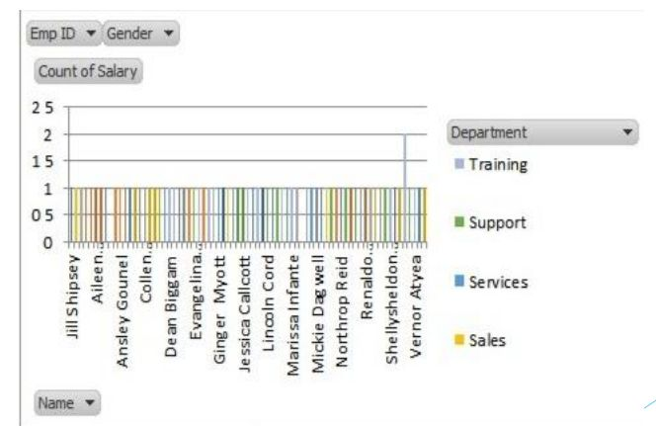
RESULTS
11

Slide 12
conclusion
In conclusion, analyzing salary and compensation data through Excel data modeling provides valuable insights into compensation trends and disparities within an organization.
•By leveraging Excel's robust analytical tools, such as pivot tables, charts, and formulas, businesses can effectively identify patterns, benchmark salaries, and ensure equitable compensation practices.
•This approach not only aids in making informed decisions but also enhances transparency and alignment with industry standards, ultimately supporting strategic human resource planning and improving overall organizational effectiveness.

